Slide 1
Project #4 Proposal
By Samantha Garaicoa

Slide 2
Super Basic Concept:
Use the Cocktail Database (http://www.thecocktaildb.com/) API to render cocktail recipes on a bartender website.
User can input a query in a search form that, on submit, sends an Axios call to the API that outputs the name of the cocktail, ID, ingredients, and photo

Slide 3
Minimum Viable Product
Search Form
Random Drink of the Day
Resources
Links to other great bartending/cocktails websites/apps
Link to NYC Food Protection Certification
Tips on how to pass
Beginner Bartender Guide
After user has completed the guide, they’ll be directed to a quiz that, if they pass, will be able post their certificate on Facebook (super reach goal: OAuth)
Forum for bartenders (thread/comments section)
About Me
Contact Info - Social Media

Slide 4
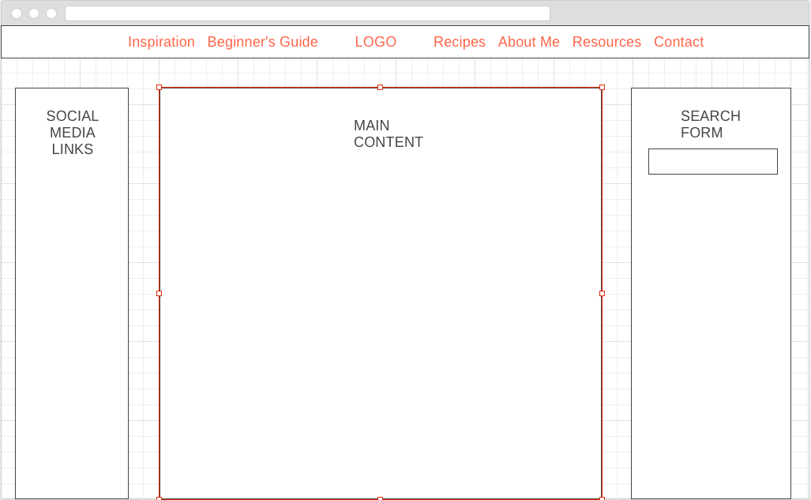

Slide 5
Proposed Technologies
React.js
Axios
Node.js
Express
CocktailDB API
HTML
CSS

Slide 6
Future Goals
Create a podcast for female city bartenders
What are our experiences in this industry?
Advice for women starting off in this industry
Social issues involved
Sexism
Racism
Objectification
What is my target audience? I don’t want anyone to feel excluded - having men on the show would be fun, too!
Go to beer/alcohol convention and talk to people passionate about these things
Have a female restaurant manager talk on the show

Slide 7
Future Goals cont.
Have guest bartenders write articles/interview guest bartenders
Get a bigger audience through social media and networking
Make this a real thing that people use!
I am so passionate about this project and my bartending life - what better way to incorporate my two worlds?

Slide 8
Look at me, bartending! :D

